Slide 1
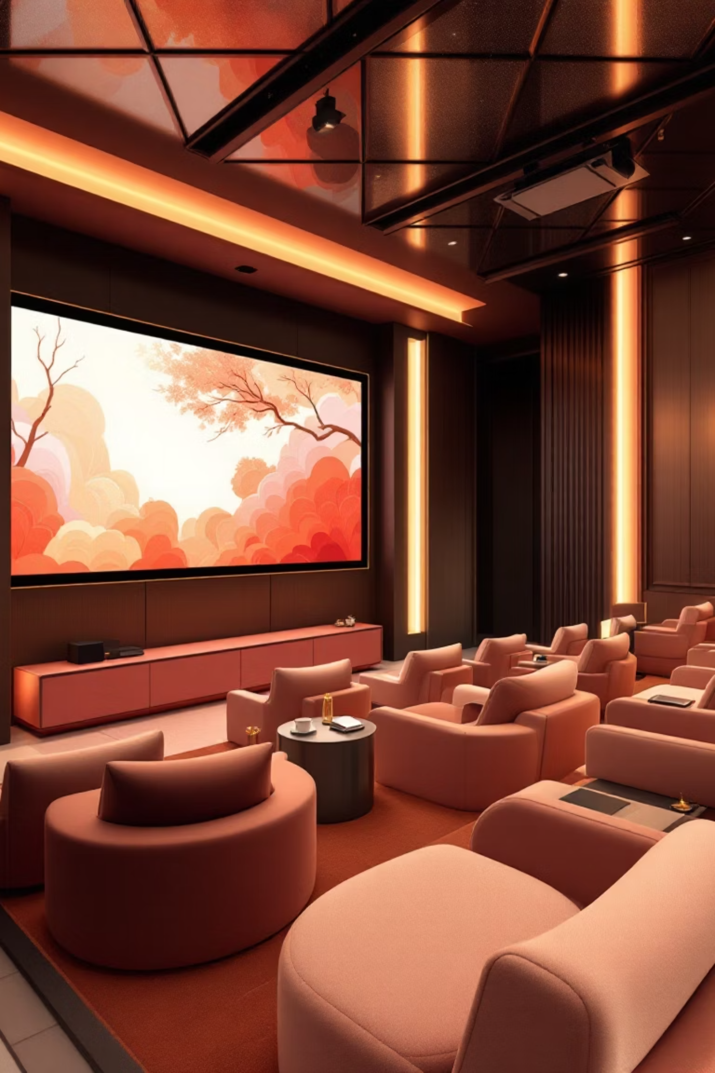

Szabadság Mozi
Modern web platform for cinema management

Slide 2



Project Overview
Angular 21
Laravel 12
Modern frontend framework with standalone components and reactive services
Robust backend API with RESTful endpoints and Eloquent ORM
MySQL 8.0
Relational database with normalized structure and optimized queries

Slide 3
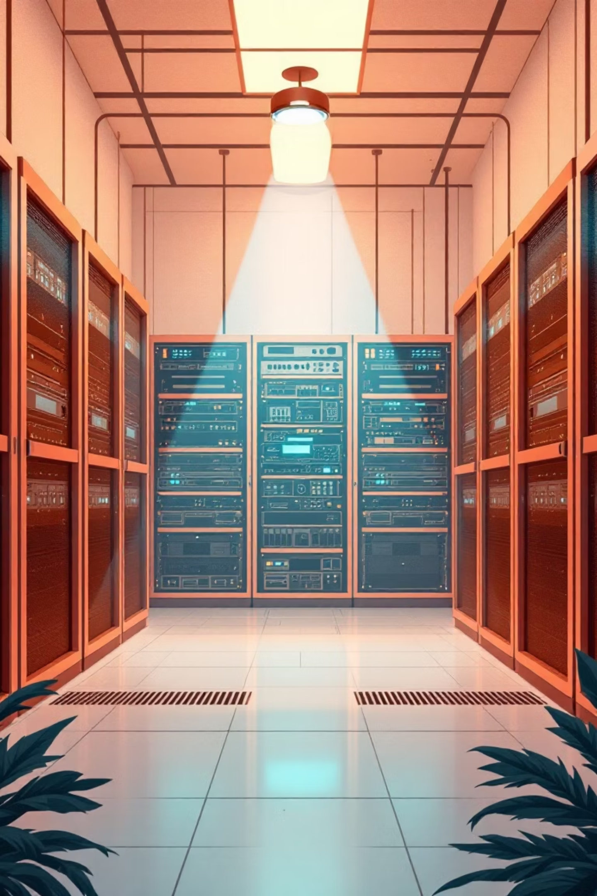

Backend Architecture
RESTful API
Security Features
Complete CRUD operations with proper HTTP methods and status codes
CORS configuration for frontend communication
Input validation and sanitization
CSRF protection
SQL injection prevention
Database Models
Movie entity with comprehensive attributes
Showtime management system
One-to-Many relationships
Development Tools
Seeder for sample data, migrations for schema management, and comprehensive testing suite

Slide 4
Frontend Architecture
Standalone Components
Reactive Services
Modern Angular architecture eliminating NgModule complexity
RxJS-based data management with observable patterns
Responsive Design
HTTP Client
Mobile and desktop support with adaptive layouts
API communication with error handling and type safety

Slide 5
API Endpoints
Method
Endpoint
Description
GET
/api/movies
Retrieve all films with showtimes
GET
/api/movies/{id}
Get detailed film information
POST
/api/movies
Create new film entry
PUT
/api/movies/{id}
Update existing film
DELETE
/api/movies/{id}
Delete film from database

Slide 6
Database Schema
Movies Table
Showtimes Table
CREATE TABLE movies (
id BIGINT UNSIGNED AUTO_INCREMENT PRIMARY KEY,
title VARCHAR(255) NOT NULL,
description TEXT NULL,
poster_url VARCHAR(255) NULL,
age_rating INT NULL,
status VARCHAR(50) DEFAULT 'current',
duration INT NULL,
genre VARCHAR(100) NULL,
release_date DATE NULL,
created_at TIMESTAMP,
updated_at TIMESTAMP
);
CREATE TABLE showtimes (
id BIGINT UNSIGNED AUTO_INCREMENT PRIMARY KEY,
movie_id BIGINT UNSIGNED NOT NULL,
showtime DATETIME NOT NULL,
hall VARCHAR(50) NULL,
format VARCHAR(50) NULL,
created_at TIMESTAMP,
updated_at TIMESTAMP,
FOREIGN KEY (movie_id) REFERENCES movies(id)
ON DELETE CASCADE
);

Slide 7

Design System
Color Palette
Typography
Layout Principles
Primary gradient from #1e3c72 to #2a5298, light grey background (#f5f5f5), dark text (#333), accent blue (#3498db), and dark footer (#2c3e50)
Segoe UI font stack with 32px bold headers, 20px medium subheaders, and 14-16px regular text for optimal readability
Maximum width of 1200px with 15-30px gaps, 8-12px border radius for cards, and subtle shadows (0 4px 15px rgba(0,0,0,0.1))

Slide 8
Quick Start Guide
Backend Launch
Database Setup
Install dependencies, migrate database, seed data, and start server
Import SQL file: mysql -u root < database.sql
Access Application
Frontend Launch
Open http://localhost:4200 in your browser
Install npm packages and start development server

Slide 9

Performance & Security
Performance Metrics
Testing
Initial load: ~35 KB (Angular bundle)
API response: < 100ms (locally)
Responsive breakpoints for all devices
Comprehensive test suites for both backend (php artisan test) and frontend (npm test) ensure code quality and reliability
Future Enhancements
Security Measures
Server-side rendering
Progressive Web App
Image lazy loading
Caching strategy
CDN integration
CSRF protection
SQL injection prevention
XSS sanitization
CORS configuration
Input validation

Slide 10





Future Development Roadmap
Phase 1
Ticket booking system, user authentication, admin dashboard, detailed film pages
Phase 2
Barion payment integration, email notifications, push notifications, social sharing
Phase 3
Search functionality, filters and sorting, user reviews, favorites list, QR code generation
Phase 4
SSR implementation, PWA support, lazy loading, caching strategy, CDN integration

